Slide 1



Fluid Dynamic, Aero Dynamics, Low & High Speed Dynamics
Presented By
Mrs. A. Animhons
Assistant Professor
Department of Aeronautical
Excel Engineering College
(Autonomous)
Komaparapalayam, Namakkal- 637 303.

Slide 2
Chapter 1
Introduction to Fluid Mechanics

Slide 3
Definition
Mechanics is the oldest physical science that deals with both stationary and moving bodies under the influence of forces.
The branch of mechanics that deals with bodies at rest is called statics, while the branch that deals with bodies in motion is called dynamics.
The subcategory fluid mechanics is defined as the science that deals with the behavior of fluids at rest (fluid statics) or in motion (fluid dynamics), and the interaction of fluids with solids or other fluids at the boundaries.
The study of fluids at rest is called fluid statics.

Slide 4
Definition
The study of f1uids in motion, where pressure forces are not considered, is called fluid kinematics and if the pressure forces are also considered for the fluids in motion. that branch of science is called fluid dynamics.
Fluid mechanics itself is also divided into several categories.
The study of the motion of fluids that are practically incompressible (such as liquids, especially water, and gases at low speeds) is usually referred to as hydrodynamics.
A subcategory of hydrodynamics is hydraulics, which deals with liquid flows in pipes and open channels.

Slide 5
Definition
Gas dynamics deals with the flow of fluids that undergo significant density changes, such as the flow of gases through nozzles at high speeds.
The category aerodynamics deals with the flow of gases (especially air) over bodies such as aircraft, rockets, and automobiles at high or low speeds.

Slide 6
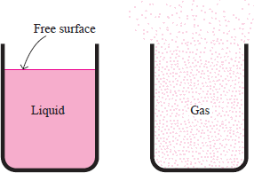
What is a Fluid?
In a liquid, molecules can move relative to each other, but the volume remains relatively constant because of the strong cohesive forces between the molecules.
As a result, a liquid takes the shape of the container it is in, and it forms a free surface in a larger container in a gravitational field.
A gas, on the other hand, expands until it encounters the walls of the container and fills the entire available space.
This is because the gas molecules are widely spaced, and the cohesive forces between them are very small.
Unlike liquids, gases cannot form a free surface
7

Slide 7
What is a Fluid?
Differences between liquid and gases
Liquid | Gases
Difficult to compress and often regarded as incompressible | Easily to compress – changes of volume is large, cannot normally be neglected and are related to temperature
Occupies a fixed volume and will take the shape of the container | No fixed volume, it changes volume to expand to fill the containing vessels
A free surface is formed if the volume of container is greater than the liquid. | Completely fill the vessel so that no free surface is formed.
8

Slide 8
Application areas of Fluid Mechanics
Mechanics of fluids is extremely important in many areas of engineering and science. Examples are:
Biomechanics
  Blood flow through arteries and veins
  Airflow in the lungs
  Flow of cerebral fluid
Households
  Piping systems for cold water, natural gas, and sewage
  Piping and ducting network of heating and air- conditioning systems
  refrigerator, vacuum cleaner, dish washer, washing machine, water meter, natural gas meter, air conditioner, radiator, etc.
Meteorology and Ocean Engineering
  Movements of air currents and water currents
9

Slide 9
Application areas of Fluid Mechanics
Mechanical Engineering
  Design of pumps, turbines, air-conditioning equipment, pollution-control equipment, etc.
  Design and analysis of aircraft, boats, submarines, rockets, jet engines, wind turbines, biomedical devices, the cooling of electronic components, and the transportation of water, crude oil, and natural gas.
Civil Engineering
  Transport of river sediments
  Pollution of air and water
  Design of piping systems
  Flood control systems
Chemical Engineering
  Design of chemical processing equipment
10

Slide 10
Application areas of Fluid Mechanics
Turbomachines: pump, turbine, fan, blower, propeller, etc.
Military: Missile, aircraft, ship, underwater vehicle, dispersion of chemical agents, etc.
Automobile: IC engine, air conditioning, fuel flow, external aerodynamics, etc.
Medicine: Heart assist device, artificial heart valve, Lab-on-a- Chip device, glucose monitor, controlled drug delivery, etc.
Electronics: Convective cooling of generated heat.
Energy: Combuster, burner, boiler, gas, hydro and wind turbine, etc.
Oil and Gas: Pipeline, pump, valve, offshore rig, oil spill cleanup, etc.
Almost everything in our world is either in contact with a fluid or is itself a fluid.
11

Slide 11
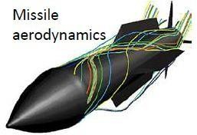
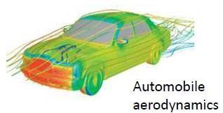
Application areas of Fluid Mechanics
The number of fluid engineering applications is enormous: breathing, blood flow, swimming, pumps, fans, turbines, airplanes, ships, rivers, windmills, pipes, missiles, icebergs, engines, filters, jets, and sprinklers, to name a few.
When you think about it, almost everything on this planet either is a fluid or moves within or near a fluid.

Slide 12
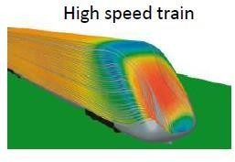
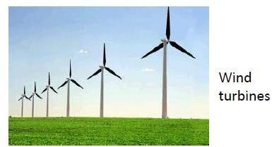
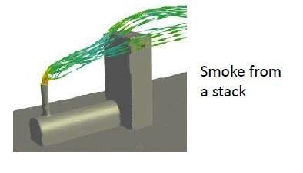
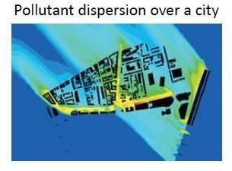
Application areas of Fluid Mechanics

Slide 13
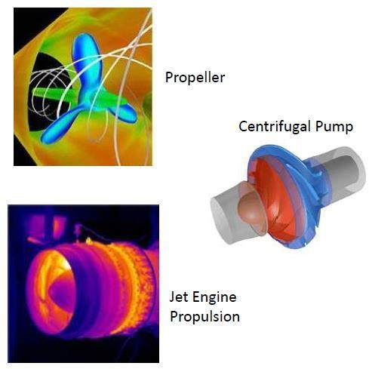
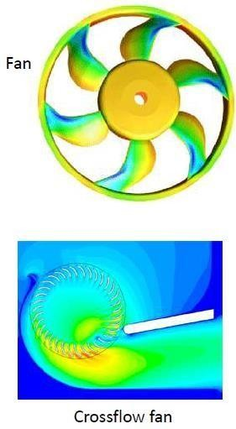
Application areas of Fluid Mechanics

Slide 14
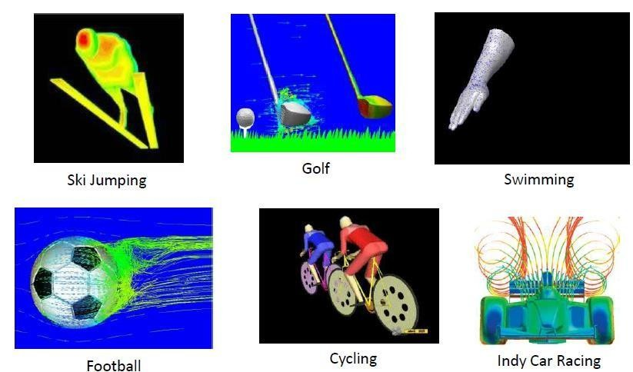
Application areas of Fluid Mechanics

Slide 15
Classification of Fluid Flows
Viscous versus Inviscid Regions of Flow…
There is no fluid with zero viscosity, and thus all fluid
flows involve viscous effects to some degree.
Flows in which the frictional effects are significant are called viscous flows.
However, in many flows of practical interest, there are regions (typically regions not close to solid surfaces) where viscous forces are negligibly small compared to inertial or pressure forces.
Neglecting the viscous terms in such inviscid flow regions greatly simplifies the analysis without much loss in accuracy.

Slide 16
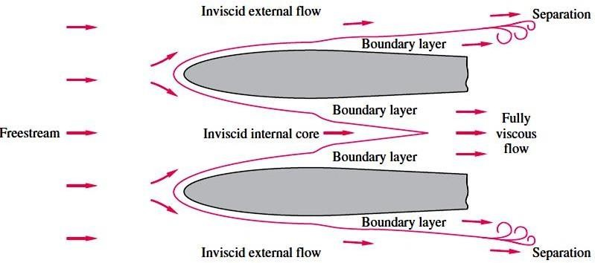
Classification of Fluid Flows
Viscous versus Inviscid Regions of Flow

Slide 17
Classification of Fluid Flows
Internal versus External Flow
A fluid flow is classified as being internal or external, depending on whether the fluid is forced to flow in a confined channel or over a surface.
The flow of an unbounded fluid over a surface such as a plate, a wire, or a pipe is external flow.
The flow in a pipe or duct is internal flow if the fluid is
completely bounded by solid surfaces.
Water flow in a pipe, for example, is internal flow, and airflow over a ball or over an exposed pipe during a windy day is external flow .

Slide 18
Classification of Fluid Flows
Compressible versus Incompressible Flow
A flow is classified as being compressible or incompressible, depending on the level of variation of density during flow.
Incompressibility is an approximation, and a flow is said to be incompressible if the density remains nearly constant throughout.
Therefore, the volume of every portion of fluid remains unchanged over the course of its motion when the flow (or the fluid) is incompressible.
The densities of liquids are essentially constant, and thus the flow of liquids is typically incompressible. Therefore, liquids are usually referred to as incompressible substances.

Slide 19
Classification of Fluid Flows
Compressible versus Incompressible Flow…
A pressure of 210 atm, for example, causes the density of liquid water at 1 atm to change by just 1 percent.
Gases, on the other hand, are highly compressible. A pressure change of just 0.01 atm, for example, causes a change of 1 percent in the density of atmospheric air.
Gas flows can often be approximated as incompressible if the density changes are under about 5 percent.
The compressibility effects of air can be neglected at speeds under about 100 m/s.

Slide 20
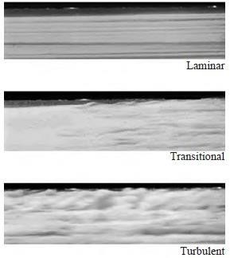
Classification of Fluid Flows
Laminar versus Turbulent Flow
Some flows are smooth and orderly
while others are rather chaotic.
The highly ordered fluid motion characterized by smooth layers of fluid is called laminar.
The flow of high-viscosity fluids such as oils at low velocities is typically laminar.
The highly disordered fluid motion that typically occurs at high velocities and is characterized by velocity fluctuations is called turbulent .

Slide 21
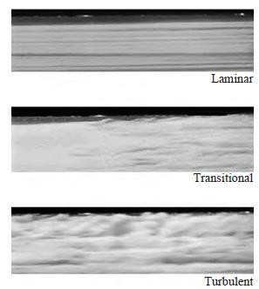
Classification of Fluid Flows
Laminar versus Turbulent Flow
The flow of low-viscosity fluids such as air at high velocities is typically turbulent.
A flow that alternates between being laminar and turbulent is called transitional.

Slide 22
Classification of Fluid Flows
Steady versus Unsteady Flow
The terms steady and uniform are used frequently in engineering, and thus it is important to have a clear understanding of their meanings.
The term steady implies no change at a point with time.
The opposite of steady is unsteady.
The term uniform implies no change with location
over a specified region.

Slide 23
Properties of Fluids
Any characteristic of a system is called a property.
Some familiar properties are pressure P, temperature T,
volume V, and mass m.
Other less familiar properties include viscosity, thermal
conductivity, modulus of elasticity,
thermal
expansion
coefficient, electric resistivity, and even velocity and
elevation.
Properties are considered to be either intensive or extensive.
Intensive properties are those that are independent of the mass of a system, such as temperature, pressure, and density.
Extensive properties are those whose values depend on the size—or extent—of the system. Total mass, total volume V, and total momentum are some examples of extensive properties.

Slide 24
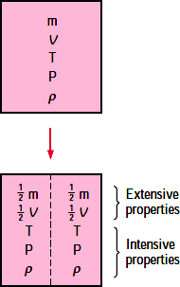
Properties of Fluids
An easy way to determine whether a property is intensive or extensive is to divide the system into two equal parts with an imaginary partition.
Each part will have the same value of intensive properties as the original system, but half the value of the extensive properties.

Slide 25
Properties of Fluids
Density or Mass Density
Density or mass density of a fluid is defined as the ratio of the mass of a f1uid to its volume. Thus mass per unit volume of a fluid is called density. It is denoted the symbol ρ (rho). The unit of mass density in SI unit is kg per cubic meter, i.e ., kg/m³.
The density of liquids may be considered as constant while that of gases changes with the variation of pressure and temperature.
Mathematically mass density is written as.
Mass of fluid
ρ =
Volume of fluid
The value of density of water is 1 gm/cm³ or 1000 kg/m³.

Slide 26
Properties of Fluids
Density or Mass Density
The density of a substance, in general, depends on temperature and pressure.
The density of most gases is proportional to pressure and
inversely proportional to temperature.
Liquids and solids, on the other hand, are essentially incompressible substances, and the variation of their density with pressure is usually negligible.

Slide 27
Properties of Fluids
Specific weight or Weight Density
Specific weight or weight density of a fluid is the ratio between the weight of a fluid to its volume.
Thus weight per unit volume of a fluid is called weight density and it is denoted by the symbol w.
Mathematically,
_{w =} Weight of fluid ₌ (Mass of fluid) x Acceleration due to gravity
Volume of fluid
₌ Mass of fluid x g Volume of fluid
= ρ x g
w = ρg
Volume of fluid

Slide 28
Properties of Fluids
Specific Volume
Specific volume of a fluid is defined as the volume of a fluid occupied by a unit mass or volume per unit mass of a fluid is called specific volume.
Mathematically, it is expressed as
1
Mass of fluid
Volume
₌ 1
Specific volume = ^{Volume offluid} =
Mass of fluid
ρ
Thus specific volume is the reciprocal of mass density. It is expressed as m³/kg.
It is commonly applied to gases.

Slide 29
Properties of Fluids
Specific Gravity.
Specific gravity is defined as the ratio of the weight density (or density) of a fluid to the weight density (or density) of a standard fluid.
For liquids, the standard fluid is taken water and for gases, the standard fluid is taken air. Specific gravity is also called relative density. It is dimensionless quantity and is denoted by the symbol S.
_{S(for liquids) =} Weight density (density) of liquid
Weight density (density) of water
_{S(for gases) =} Weight density (density) of gas
Weight density (density) of air
Thus weight density of a liquid = S x Weight densityof water
= S x 1000x 9.81N/m³ Thus density of a liquid = S x Densityof water
= S x 1000kg/m³
32

Slide 30
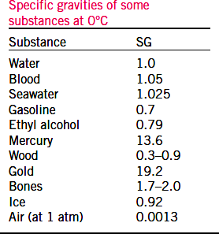
Properties of Fluids
Specific Gravity.
If the specific gravity of a fluid is known, then the density of the fluid will be equal to specific gravity of fluid multiplied by the density of water.
For example the specific gravity of mercury is 13.6, hence density of mercury
= 13.6 x 1000 = 13600
kg/m³.

Slide 31
Flow Patterns
Fluid mechanics is a highly visual subject. The patterns of flow can be visualized in a dozen different ways, and you can view these sketches or photographs and learn a great deal qualitatively and often quantitatively about the flow.
Four basic types of line patterns are used to visualize flows:
  A streamline is a line everywhere tangent to the velocity vector at a given instant.
  A pathline is the actual path traversed by a given fluid particle.
  A streakline is the locus of particles that have earlierpassed through a prescribed point.
  A timeline is a set of fluid particles that form a line at a given instant.

Slide 32
Flow Patterns
The streamline is convenient to calculate mathematically, while the other three are easier to generate experimentally.
Note that a streamline and a timeline are instantaneous lines, while the pathline and the streakline are generated by the passage of time.
A streamline is a line that is everywhere tangent to the velocity field. If the flow is steady, nothing at a fixed point (including the velocity direction) changes with time, so the streamlines are fixed lines in space.
For unsteady flows the streamlines may change shape with time.
A pathline is the line traced out by a given particle as itflows from one point to another.

Slide 33
Flow Patterns
A streakline consists of all particles in a flow that have previously passed through a common point. Streaklines are more of a laboratory tool than an analytical tool.
They can be obtained by taking instantaneous photographs of marked particles that all passed through a given location in the flow field at some earlier time.
Such a line can be produced by continuously injecting marked fluid (neutrally buoyant smoke in air, or dye in water) at a given location.
If the flow is steady, each successively injected particle follows precisely behind the previous one forming a steady streakline that is exactly the same as the streamline through the injection point.

Slide 34
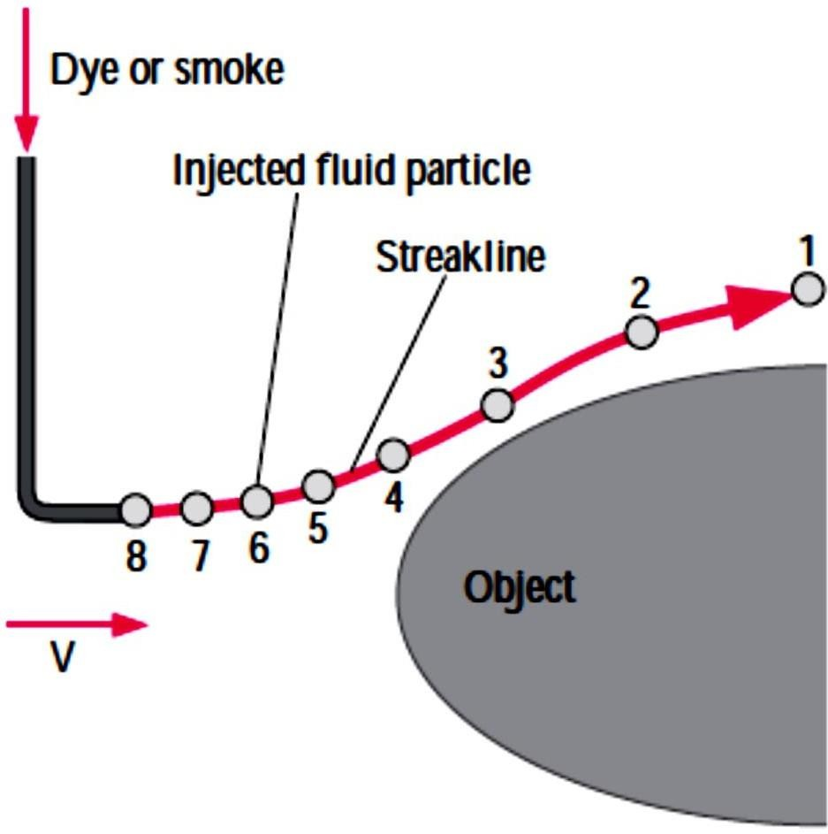
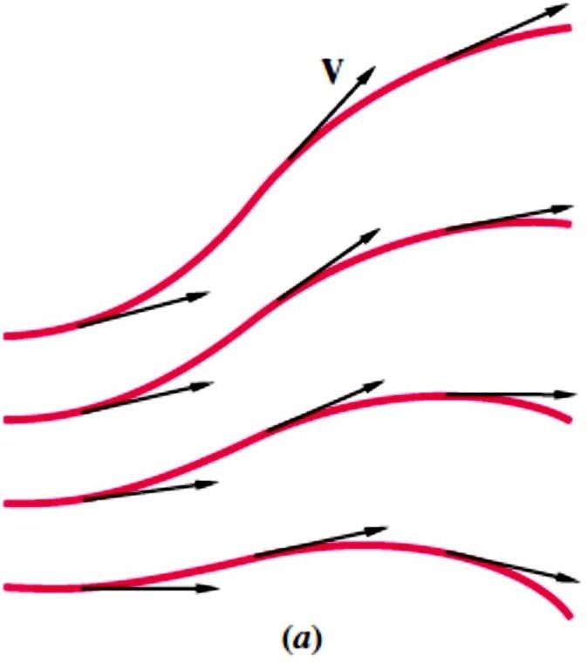
Flow Patterns
(a) Streamlines
(b) Streaklines

Slide 35
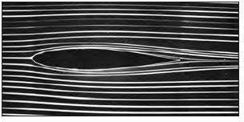
Flow Patterns
Streaklines are often confused with streamlines or pathlines.
While the three flow patterns are identical in steady flow, they can be quite different in unsteady flow.
The main difference is that a streamline represents an instantaneous flow pattern at a given instant in time, while a streakline and a pathline are flow patterns that have some age and thus a time history associated with them.
If the flow is steady, streamlines, pathlines, and streaklines are identical

Slide 36
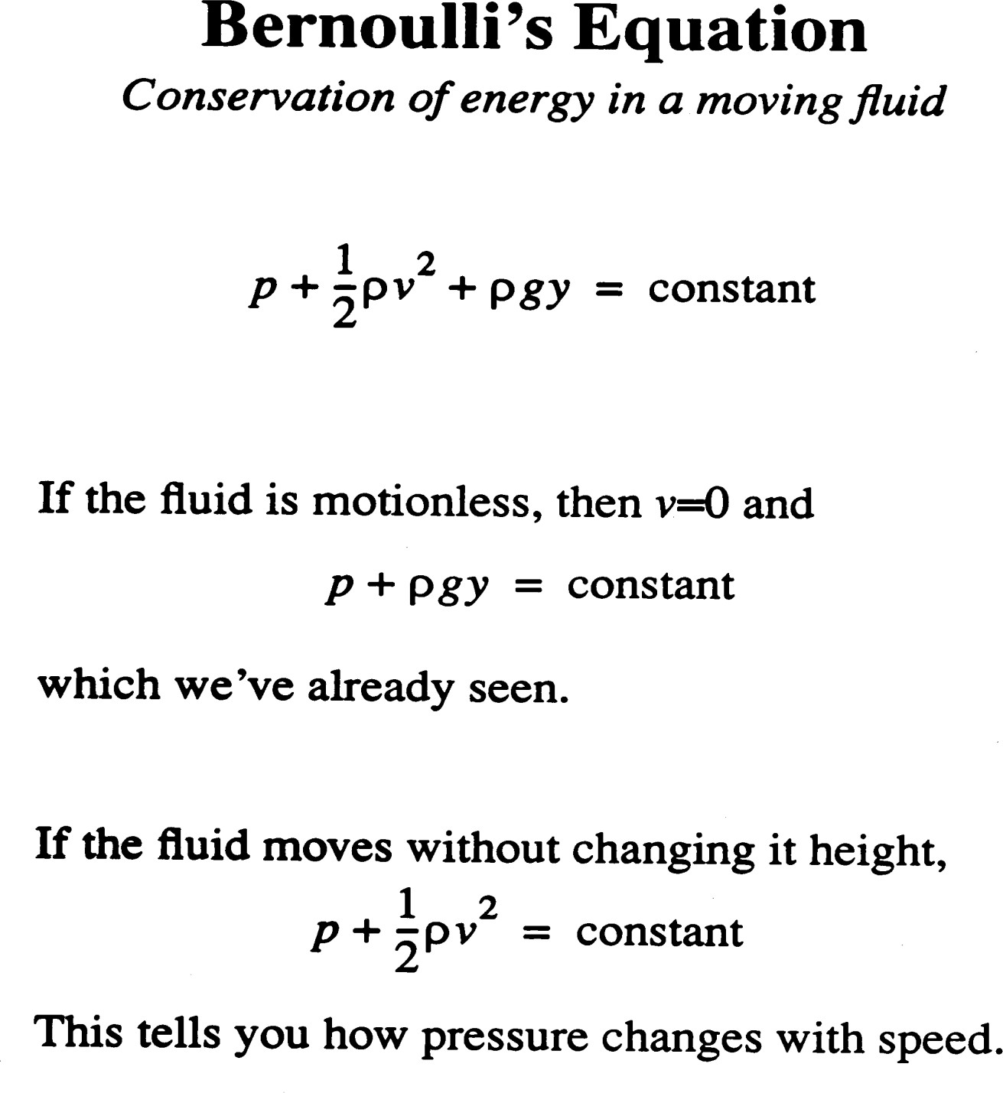

Slide 37
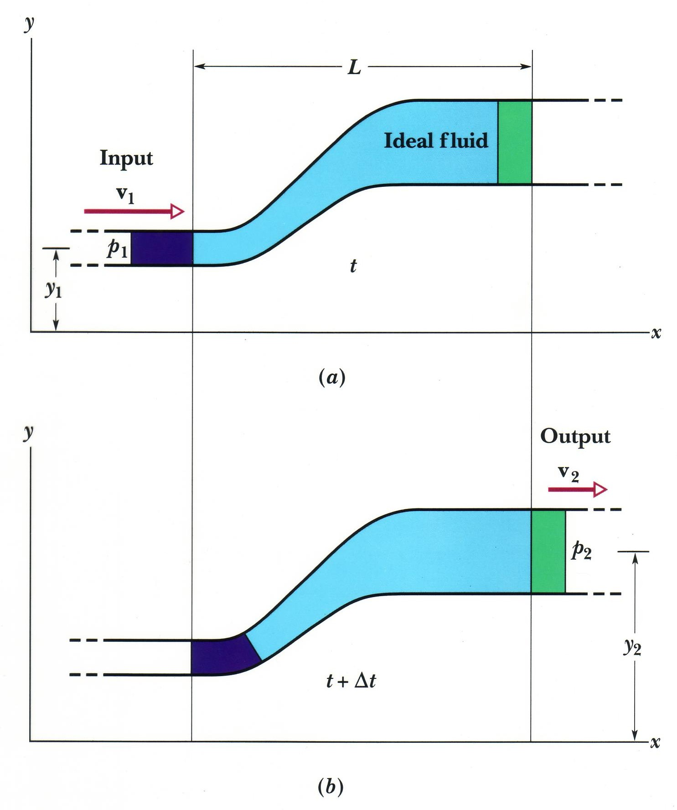

Slide 38
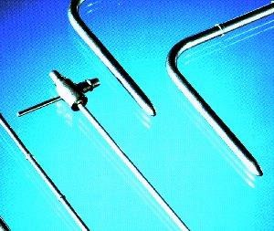

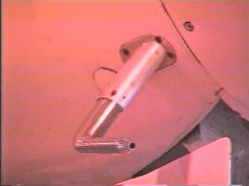
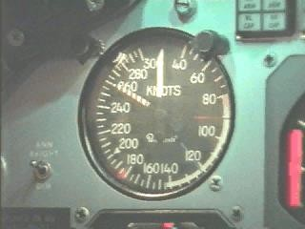
Pitot Tubes
Used to measure air speed on airplanes
Can connect a differential pressure transducer to directly measure V²/2g
Can be used to measure the flow of water
in pipelines
Point measurement!

Slide 39
Bernoulli Equation Applications
Stagnation tube
Pitot tube
Free Jets
Orifice
Venturi
Sluice gate
Sharp-crested weir
Applicable to contracting
streamlines
(accelerating
flow).

Slide 40
Basics of Aerodynamics

Slide 41


Slide 42
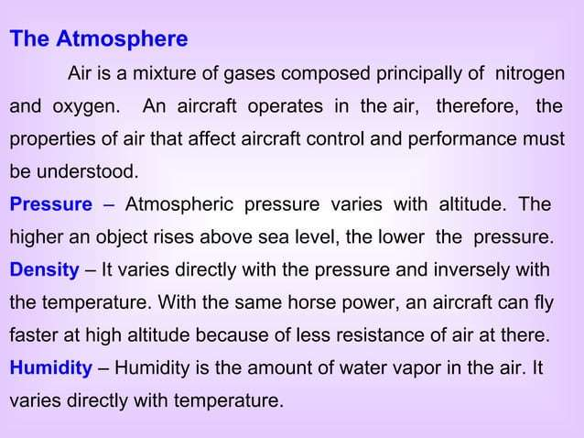

Slide 43
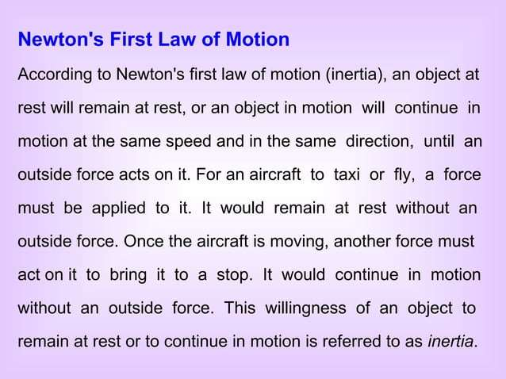

Slide 44
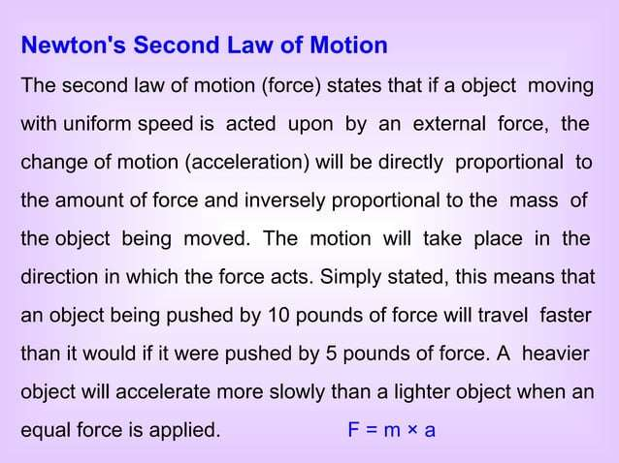

Slide 45
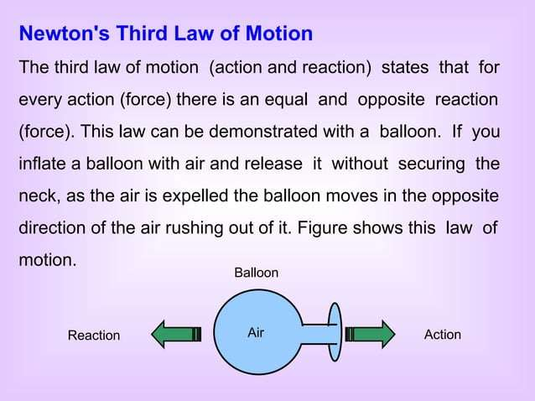

Slide 46
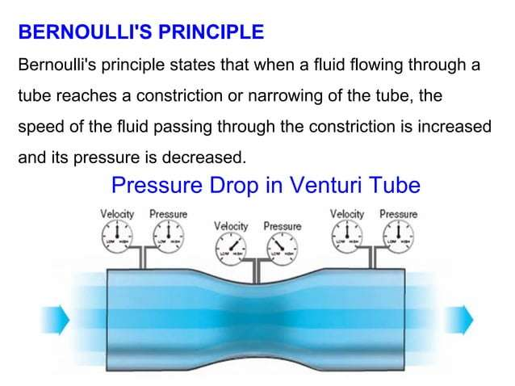

Slide 47
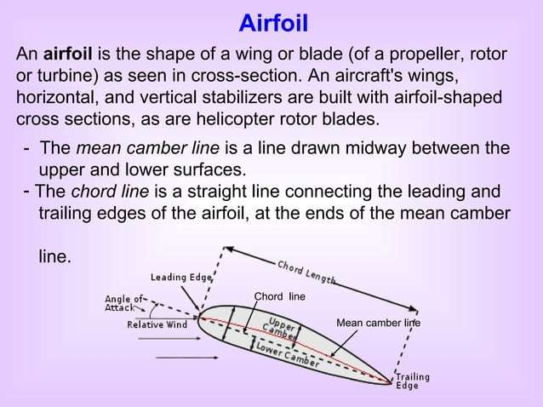

Slide 48
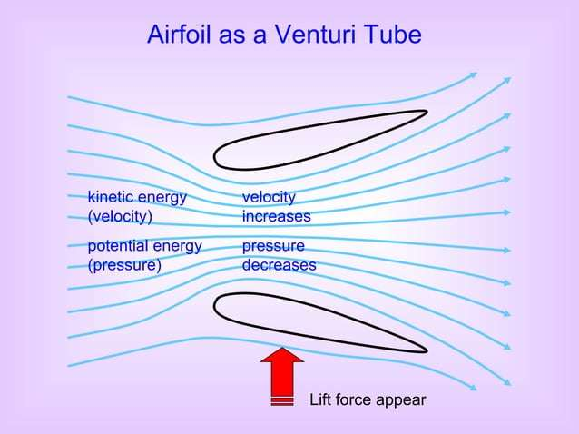

Slide 49
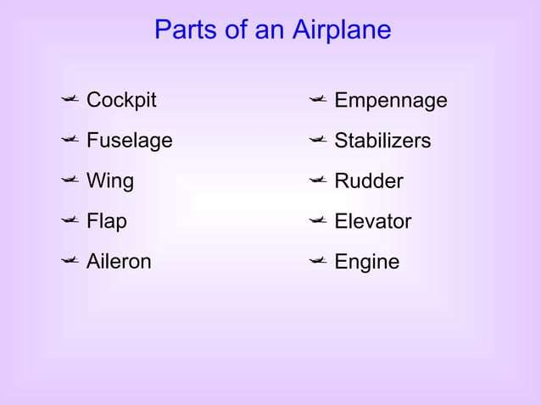

Slide 50
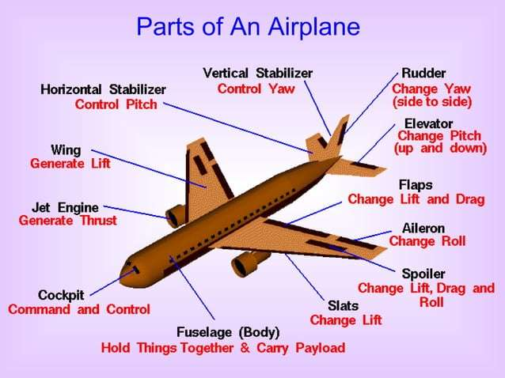

Slide 51
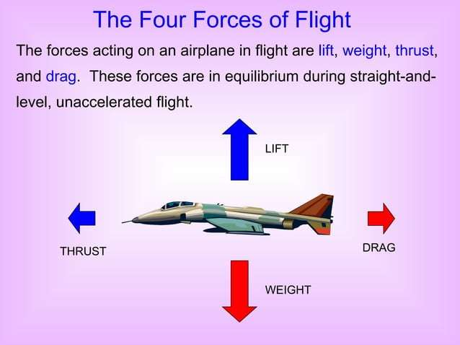

Slide 52


Slide 53
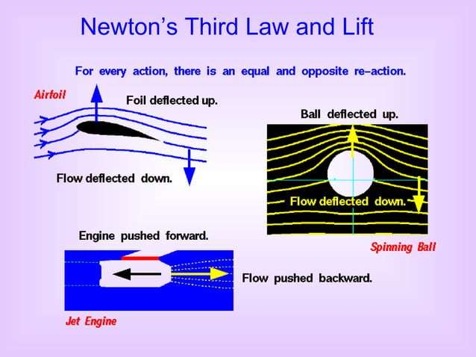

Slide 54
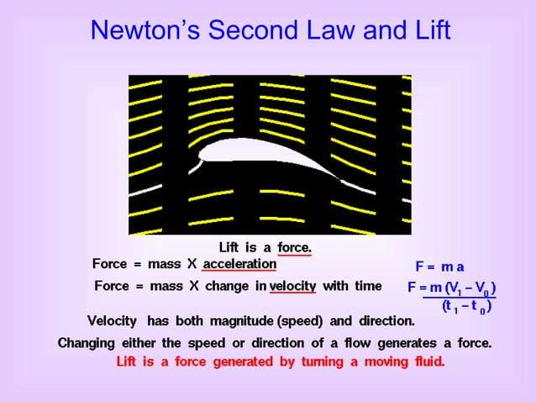

Slide 55
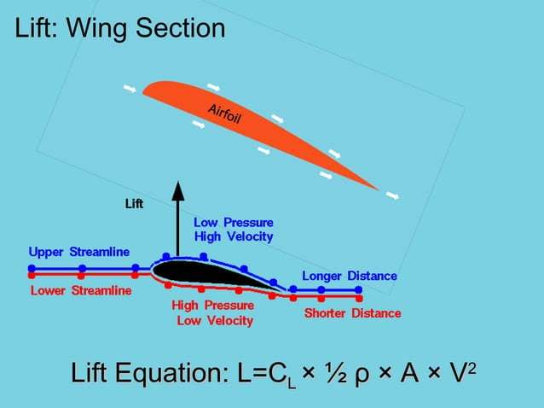

Slide 56
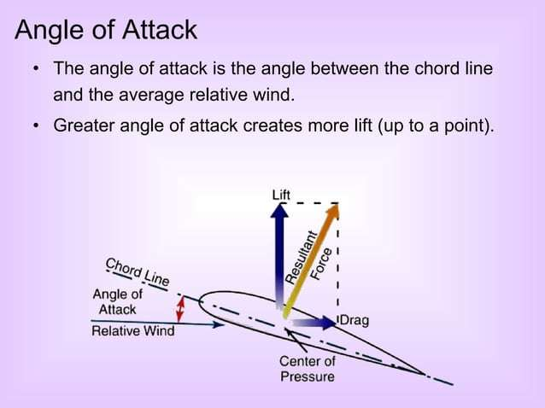

Slide 57
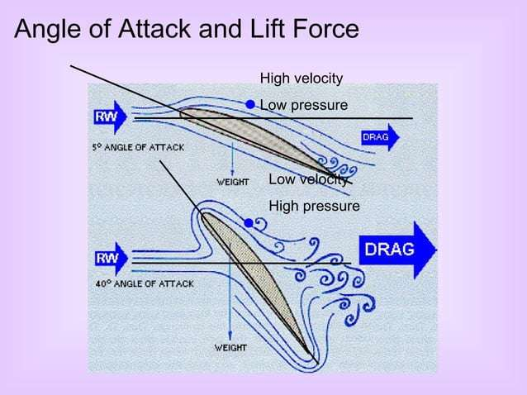

Slide 58
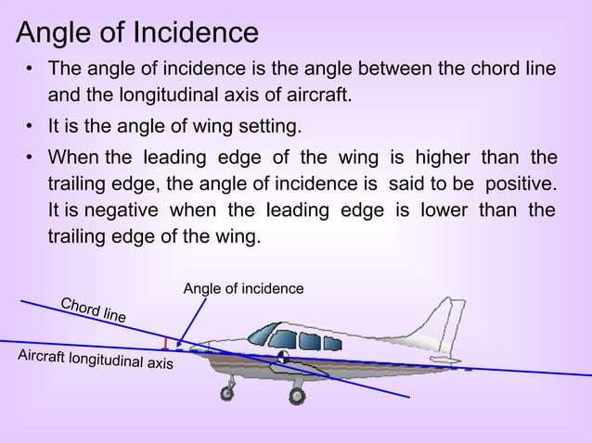

Slide 59
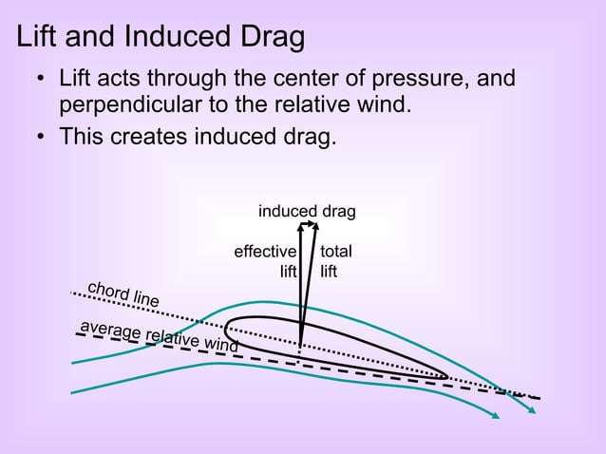

Slide 60
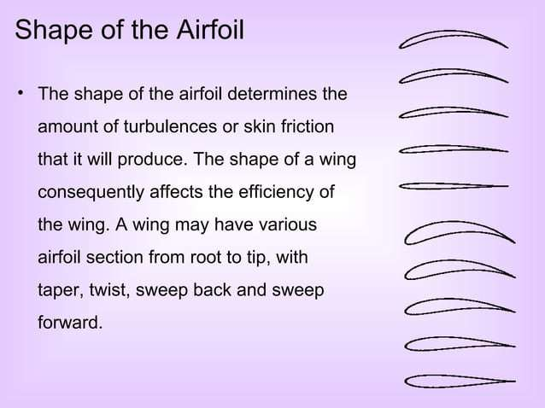

Slide 61
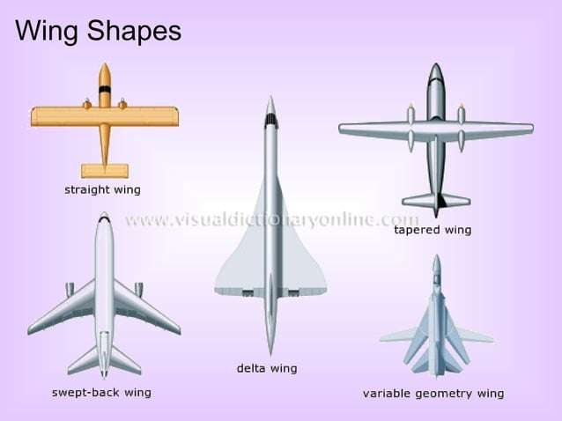

Slide 62
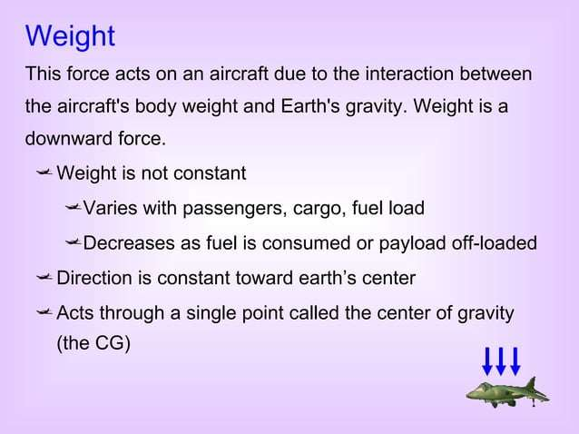

Slide 63
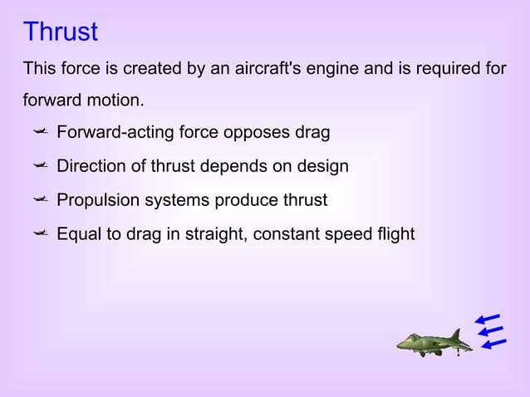

Slide 64
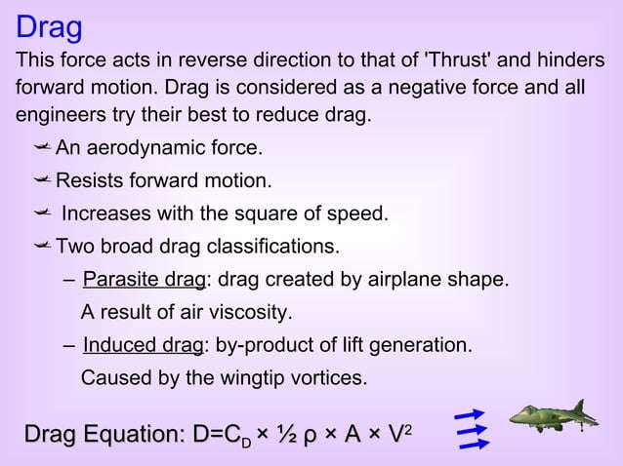

Slide 65
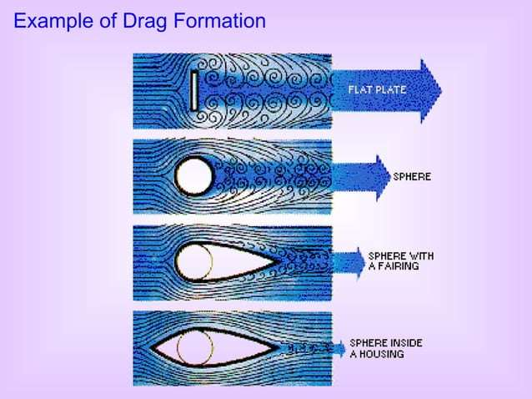

Slide 66
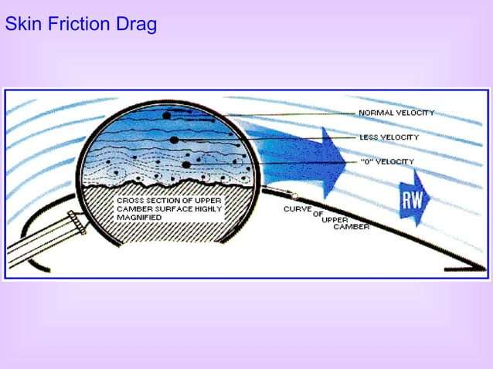

Slide 67
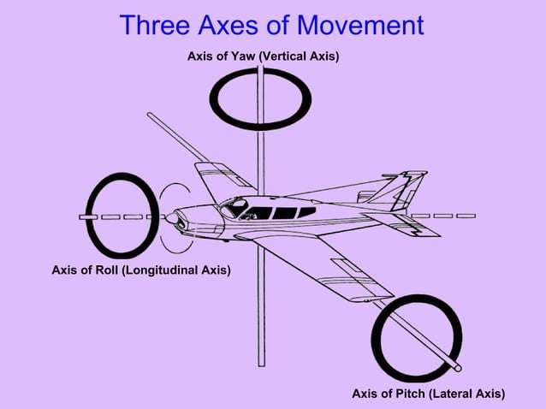

Slide 68
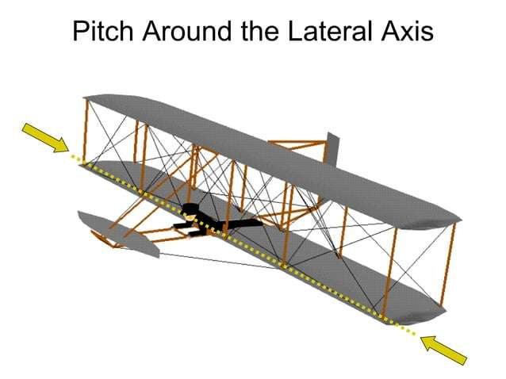

Slide 69
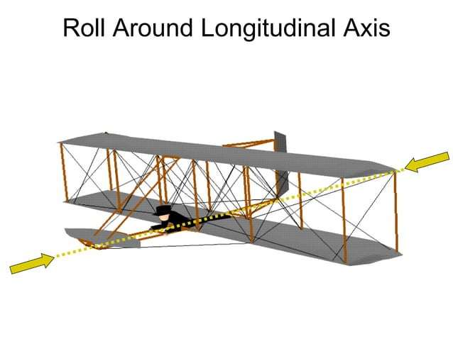

Slide 70


Slide 71


Slide 72


Slide 73


Slide 74


Slide 75


Slide 76


Slide 77


Slide 78


Slide 79


Slide 80


Slide 81


Slide 82


Slide 83


Slide 84


